Slide 1
Archimedes’ Masterpiece: On the Sphere and the Cylinder
Journey Through Genius Pp 99
Notes:
Archimedes also wrote on the geometry of spirals, and conoids and spheroids and provided a remarkable means of calculating the area under a parabola by summing a certain infinite geometric series
Archimedes was very far ahead of his time, covering topics of calculus as early as 200s BC
His greatest masterpiece was On the Sphere and the Cylinder a two volume book about the volumes and surface areas of spheres and related bodies, achieving for three dimensional solids what Measurement of a Circle had done for two dimensional figures
As we saw from Euclid, he knew that the volume of a Sphere was to the cube of its diameter by a constant m, so V = mD^3
This book also started with a list of definitions and postulates and from there derived even more sophisticated theorems
The first proposition was “If a polygon is circumscribed about a circle, then the perimeter of the polygon is greater than the circumference of the circle”
Proposition 13: “The surface of any right circular cylinder excluding the bases is equal to a circle whose radius is a mean proportional between the side of the cylinder and the diameter of the base” Notes: in modern terminology -- lateral surface (cylinder) = area (circle) = pi * x^2 = 2 * pi * r * h
Archimedes continued with a few more like-sounding propositions finally reaching the big result, surface area of a sphere
Archimedes used a similar approach using the method of exhaustion and approximating the surface area through using cones and frusta of cones whose surface area had previously been determined, the book does not have the space to get into covering Archimedes argument, but rather just gives us the final, important result
He had proven, Proposition 33: The surface of any sphere is equal to four times the greatest circle in it
He proved it using his favorite method, showing that it is impossible for the sphere’s surface to be any more than the largest circle’s area, and impossible to be any less than as well, showing that it is necessary to be equal to
We know that the sphere’s greatest circle area is through the hemisphere, then we can translate the formula into surface area (sphere) = 4 * pi * r^2
The sophistication of Archimedes math seemed to anticipate the ideas of modern integral calculus
Many people are bothered by the fact that the sphere’s surface is exactly four times the hemisphere area, why exactly 4?
Archimedes wrote, in a letter to Dositheus, a scholar in Alexandria, that he did not search for this great discovery, and he did not invent or create this fact, but rather stumbled upon a fortunate discovery
Proposition 34: Any sphere is equal to four times the cone which has its base equal to the greatest circle in the sphere and its height equal to the radius of the sphere
Again Archimedes expressed the volume of the sphere in non-algebraic terms, but rather terms that involved simpler geometric figures whose volume had already been determined
This also clarifies the relationship between pi and the volume constant m, some easy algebra shows that m = pi/6
Immediately after Prop 33 & 34, Archimedes commented on a cylinder circumscribed about the sphere. He asserted that the cylinder is half again as large as the sphere in both volume and surface area.
Notice, a cylinder circumscribed about a sphere has radius r, as does the sphere, and height 2r.
Total cylinder surface = 2pi*r*h + pi*r^2 + pi*r^2 = 2pi*r(2r) + 2*pi*r^2 = 6pi*r^2 = 3/2(4pi * r*r) = 3/2(spherical surface). Thus half again a sphere.
The same algebraic argument goes for volume.
Thus sums up the treatise we are examining.
Archimedes was doing mathematics thousands of years ahead of his time, never again has there been a mathematician this far ahead of his time.
Voltaire wrote, “There is more imagination in the head of Archimedes than in that of Homer.”

Slide 2
On the Sphere and the Cylinder
Archimedes wrote on the geometry of spirals, conoids, and provided the means of calculating the area under a parabola by summing a certain infinite geometric series.
From Euclid, we saw that the ratio between the volume of any sphere and the cube of its diameter is constant, we call this m
This book started with a list of definitions and postulates, and from there derived even more sophisticated theorems
The first proposition, “If a polygon is circumscribed about a circle, then the perimeter of the polygon is greater than the circumference of the circle.”

Slide 3
Proposition 13:
“The surface of any right circular cylinder excluding the bases is equal to a circle whose radius is a mean proportional between the side of the cylinder and the diameter of the base”
What does this look like in modern terminology?

Slide 4
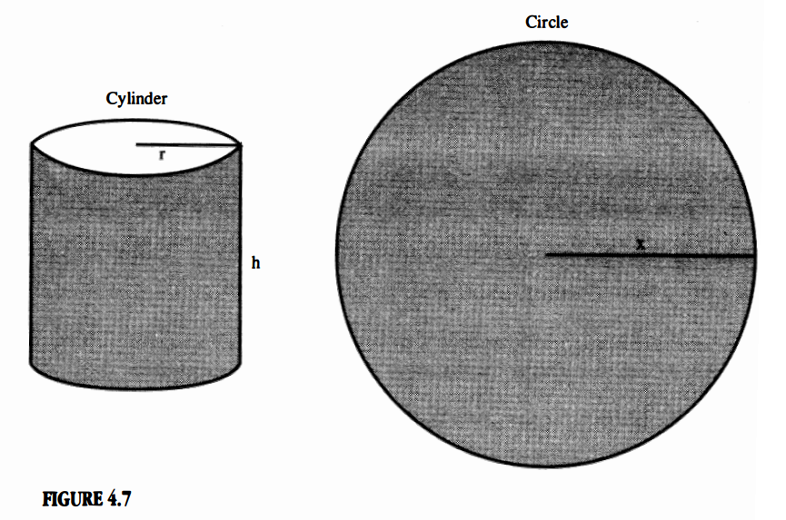
Proposition 33: The surface of any sphere is equal to four times the greatest circle in it

Slide 5
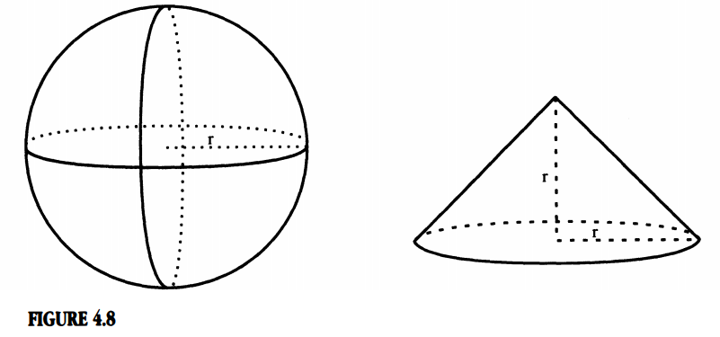
Proposition 34: Any sphere is equal to four times the cone which has its base equal to the greatest circle in the sphere and its height equal to the radius of the sphere

Slide 6
We have seen the argument for the value of the constant k, let’s examine an argument for the value of the similar volume constant, m.

Slide 7
After Proposition 33 & 34, Archimedes commented on a cylinder circumscribed about a sphere.
Let us examine the algebraic argument for volume and surface area.
He asserted that the cylinder is “half again” as large as the sphere in both volume and surface area.

Slide 8
“There is more imagination in the head of Archimedes than in that of Homer,” … Voltaire
Thus ends our journey with Archimedes

